Slide 1




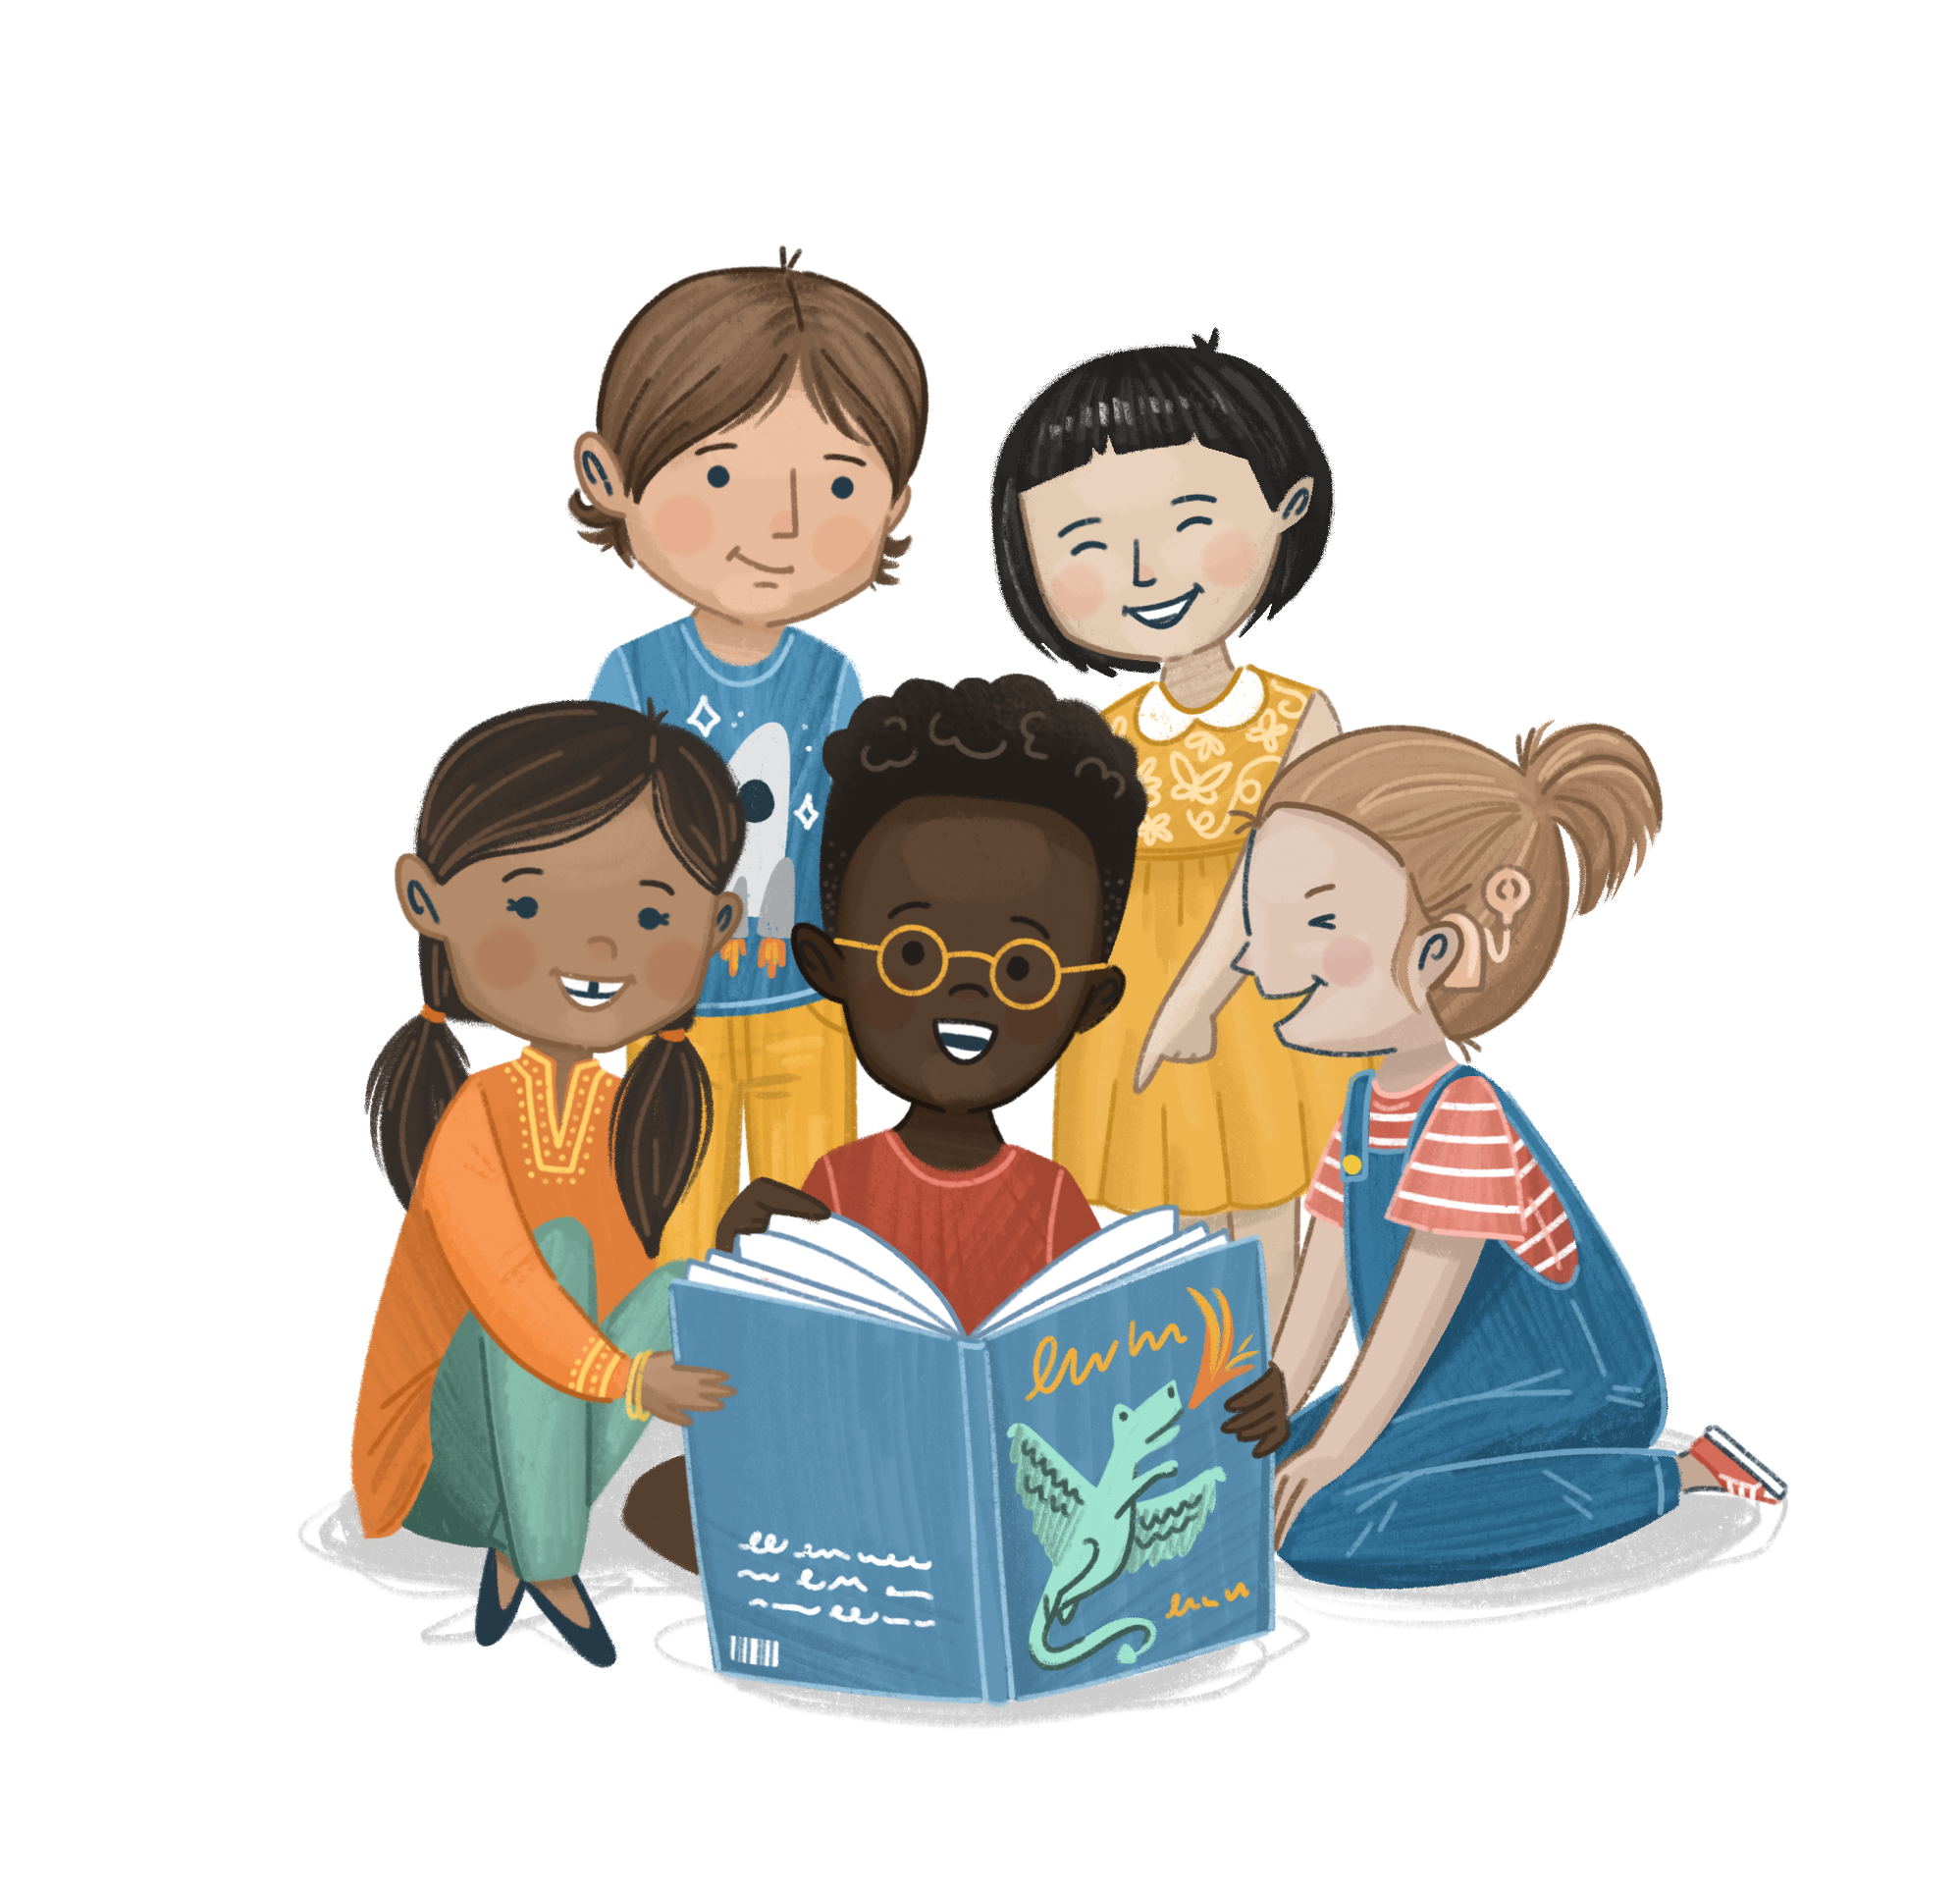

Welcome to
©The Story Project CIC

Slide 2






Emotion Check-In
How are you feeling today?

Slide 3

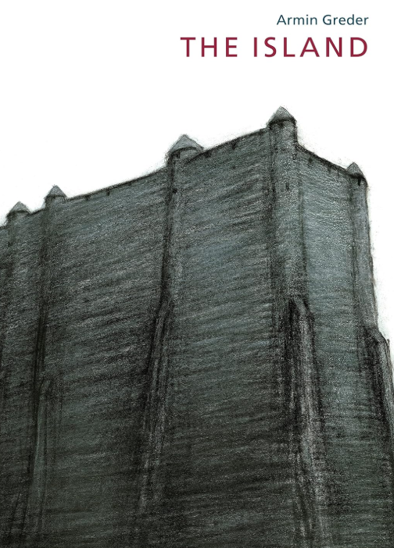
Our Book
Title:
The Island
Author and illustrator:
Armin Greder

Slide 4


Finger Trace
Let’s take one minute to settle.
Trace the outline of your hand with the index finger of your other hand.
Inhale as you move up each finger and exhale as you move down.
ettle

Slide 5
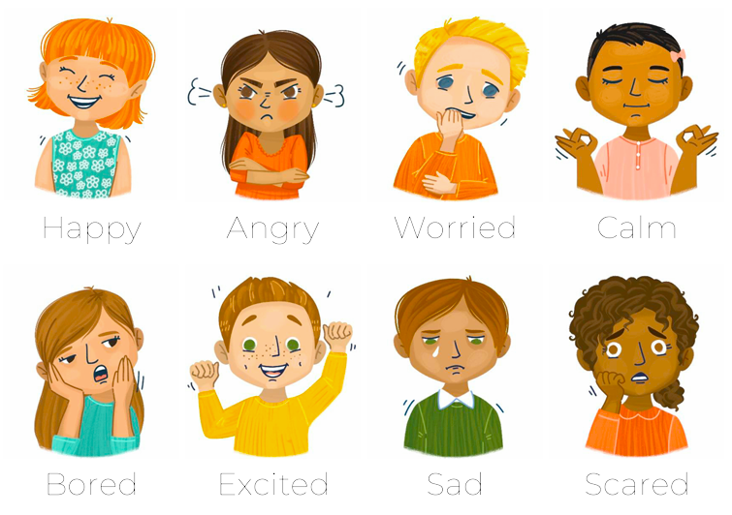
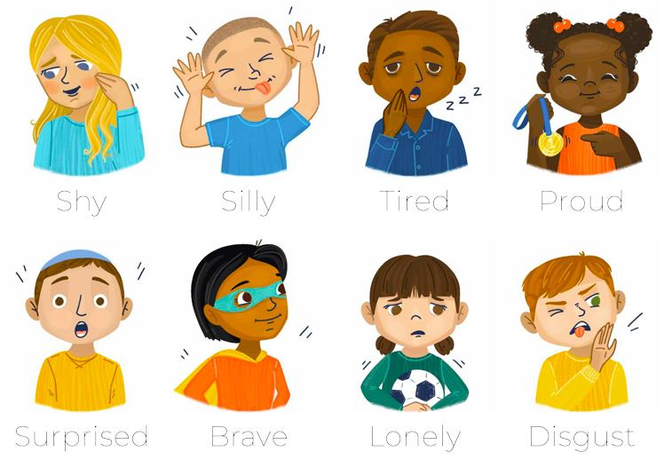
Emotional Vocabulary
Think about the character when he washes up on the shore
How could the character be feeling?
What makes you think this?
raining

Slide 6





British Values
Can you think of any examples of these in our school?
I have noticed that in our school we...
raining

Slide 7

I can understand and explore the Fundamental British Values through discussion and reflection on the themes presented in The Island by Armin Greder.
bjective

Slide 8
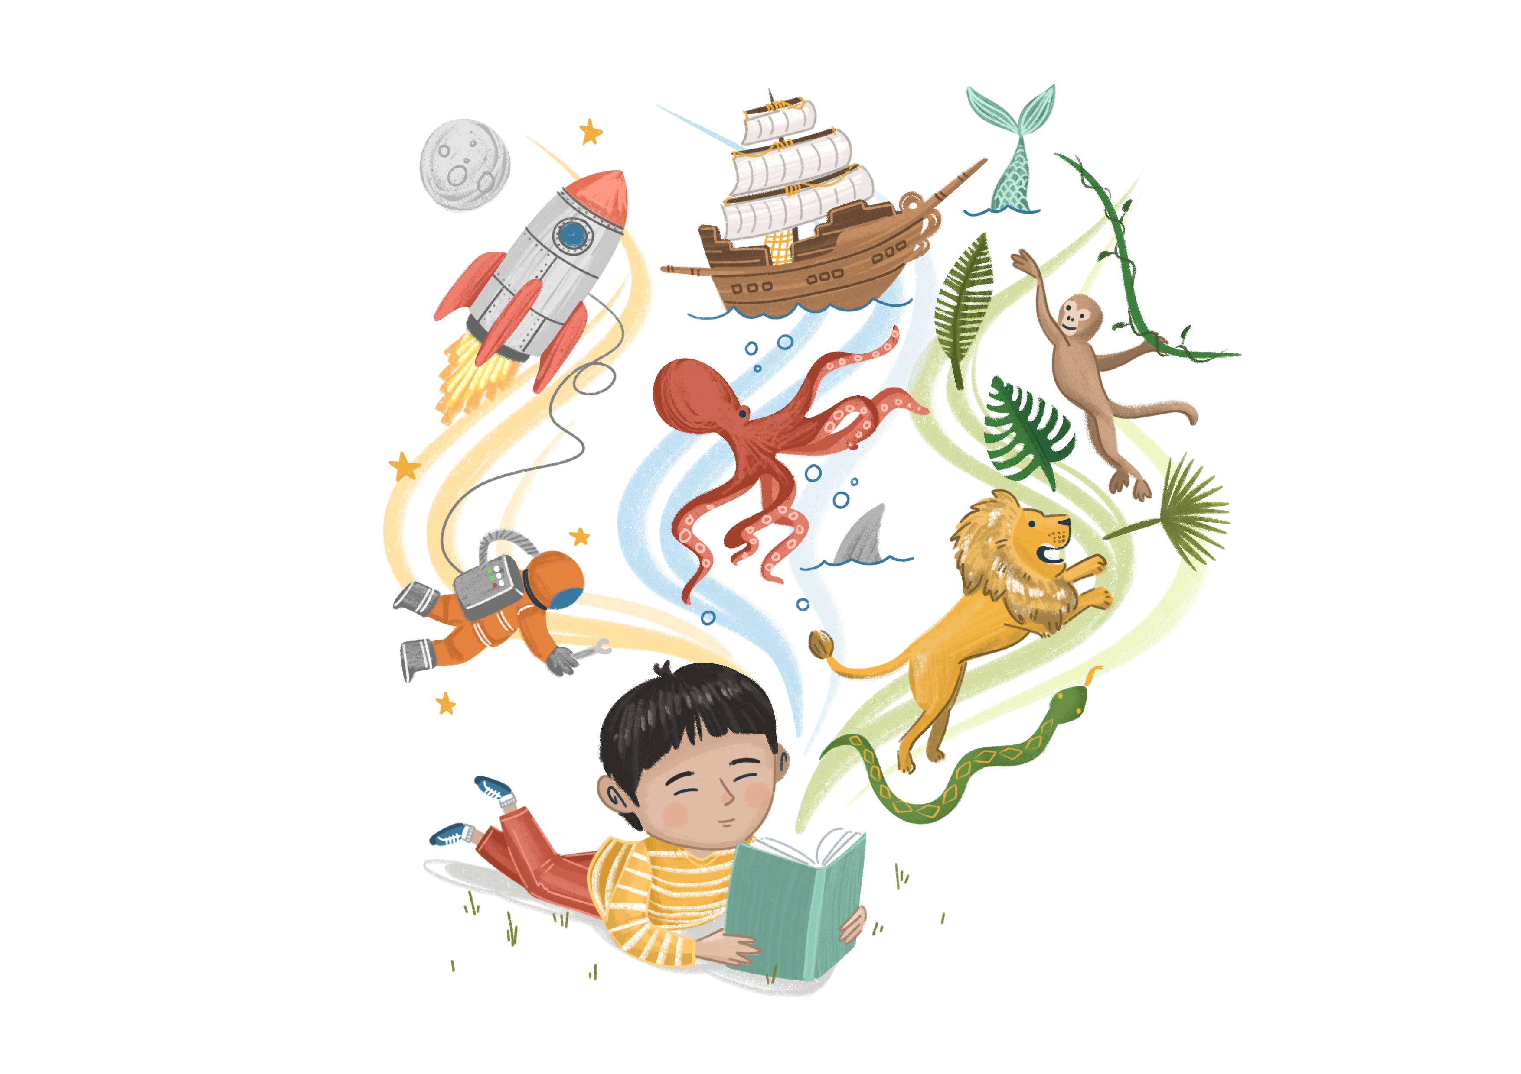
Enjoy the Story
In the book, the Island is like a country:
Do you think that the Islanders are showing British Values? Why or why not?
How did the islanders feel about the stranger?
Why do you think they responded that way?
How would you feel if you were the stranger?
How would you feel if you were one of the islanders?
Sentence starters….
I think that…
Adding to this….
To build on what ____ said….
ead

Slide 9
Class Discussion
If a new person started in our class, how could we show them the way British Values work in our school?
ou

Slide 10
Activity A
Island Diaries
Write a diary entry from the perspective of the man arriving on the Island.
What does he see?
How does he feel?
What does he think he should do?
ou

Slide 11
Activity B
Alternate Ending
Role Play an alternate ending.
What would have happened if the Islanders responded differently?
ou

