Slide 1






‘How to Mend a Friend’
A special resource to support you during difficult times
Lesson 1:
I can explain how I like to be supported during difficult times.
Lesson 2:
I can tell you how I would support a friend during difficult times.
Lesson 3:
I can explain my strengths and how they make me a good friend.

Slide 2
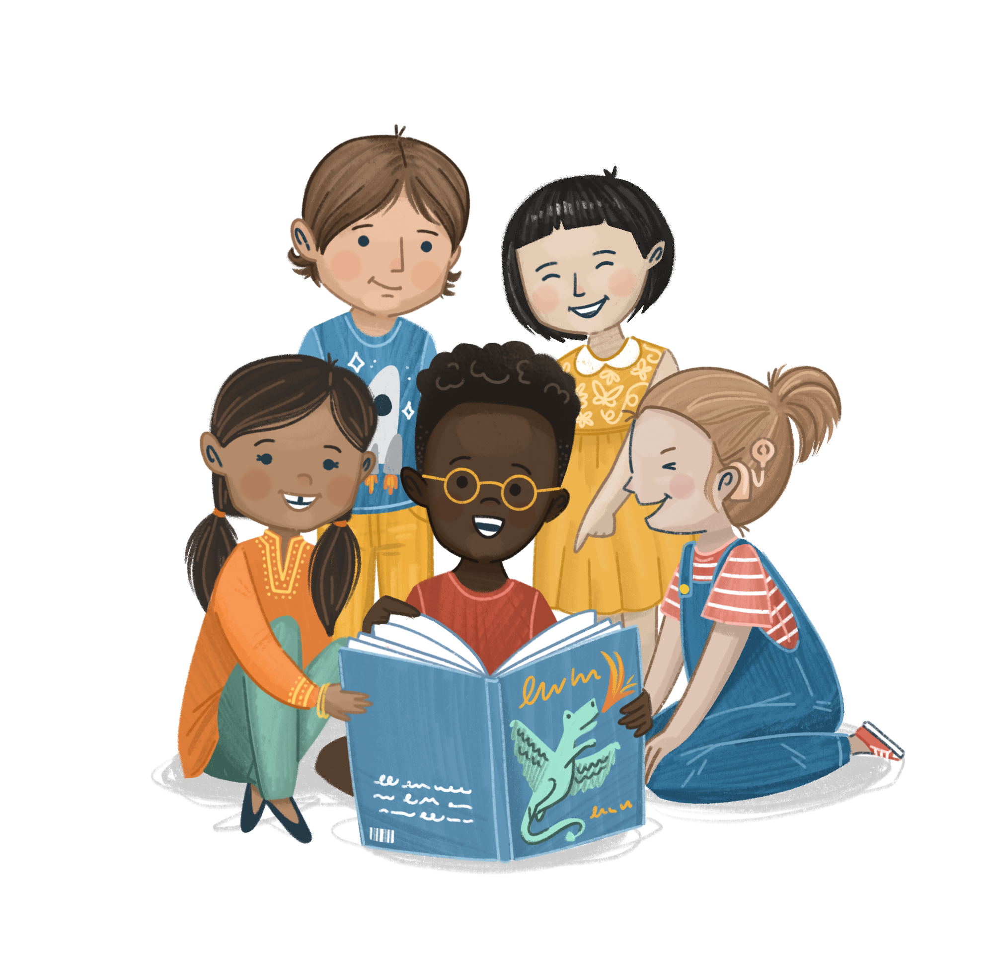
Lesson 1
Notes:
Establish Ground Rules before you begin the lesson
Ground rule suggestions:
We listen to everyone’s opinions respectfully
We join in with the lesson calmly
It is ok to have different opinions and ideas
We are inquisitive and excited to learn
If we are worried about something, we talk to a trusted adult
If we are worried about a friend or ourselves, we talk to a trusted adult
We do not have to talk about a topic that upsets us
We have fun!

Slide 3






Emotion Check-In
How are you feeling today?

Slide 4

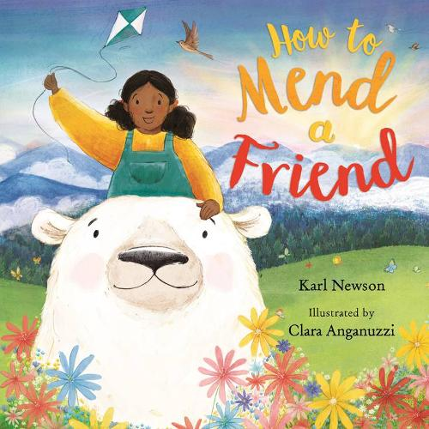
Our Book
Title:
How to Mend a Friend
Author and illustrator:
Karl Newson
Clara Anganuzzi

Slide 5
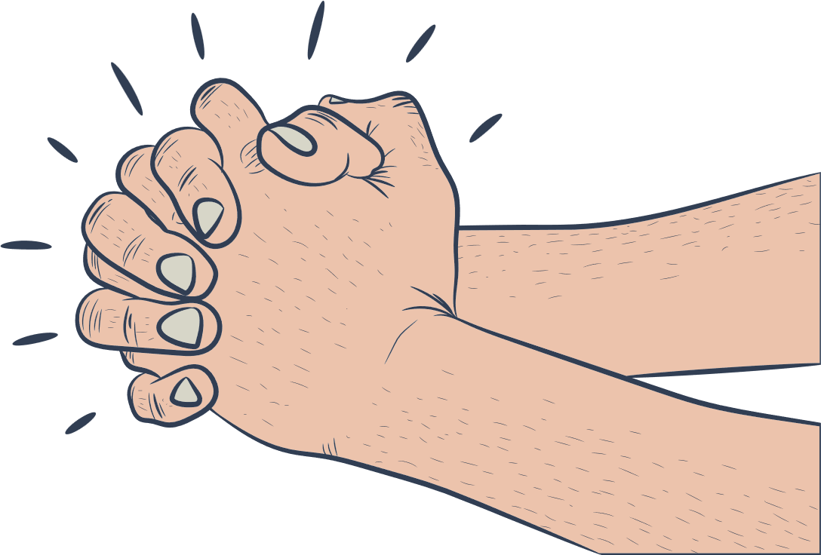
‘A Friend Who Mends’
ettle
Let’s get ready for our lesson by settling down.
Notes:
You are all wonderful friends with lots of love and support to give to each other.
Imagine all that love is in your hands. Take a deep breath and squeeze your hands together, hugging them into your chest, as though you are holding something important.
As you breath out release your hands and do a big wide stretch above your head, opening your palms and fingers wide. As you do, think about all the support and love you have for your friends and family being released into the world.
Bring your hands down to your side. Take a big, deep breath.
How did that settle activity make you feel? Could you use it next time you have big emotions?

Slide 6
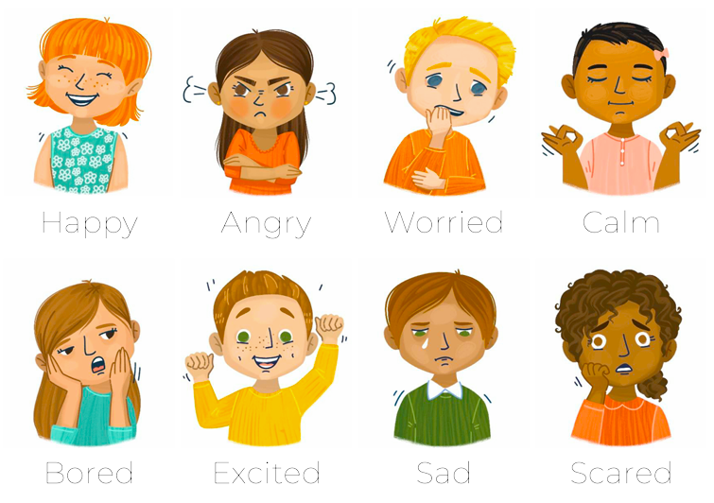
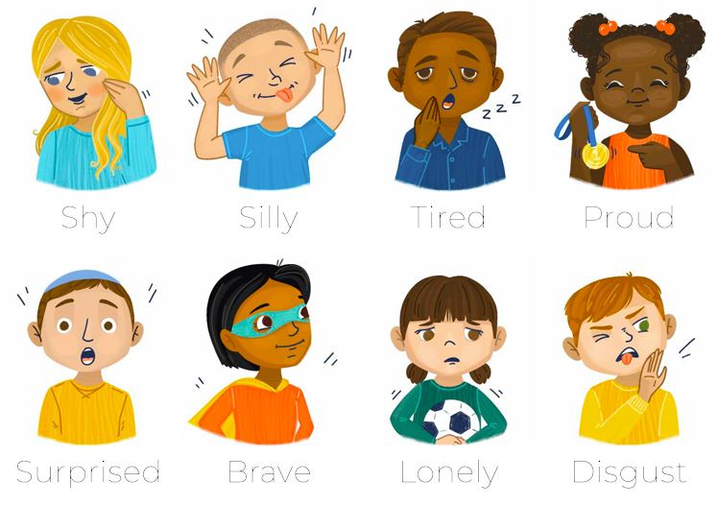
Emotional Vocabulary
Why Karl Newson, the author, wrote this story.
How do you think the bear on the back cover is feeling?
raining
Notes:
Look at the front cover of the book. Explain that the author, Karl Newson, wrote this book to reflect the love and support he received from family and friends during a difficult time in his life.
Share the blurb on the back cover and reassure children that this is a hopeful story, full of ideas of how we can support our friends.
Look at the back cover again, what emotion do children think the bear is feeling? What makes pupils think this? What do they think the girl might do to cheer up the bear?

Slide 7

I can explain how I like to be supported during difficult times.
bjective
Notes:
As they listen to the book, ask children to think about how they like to be supporting during difficult times.

Slide 8
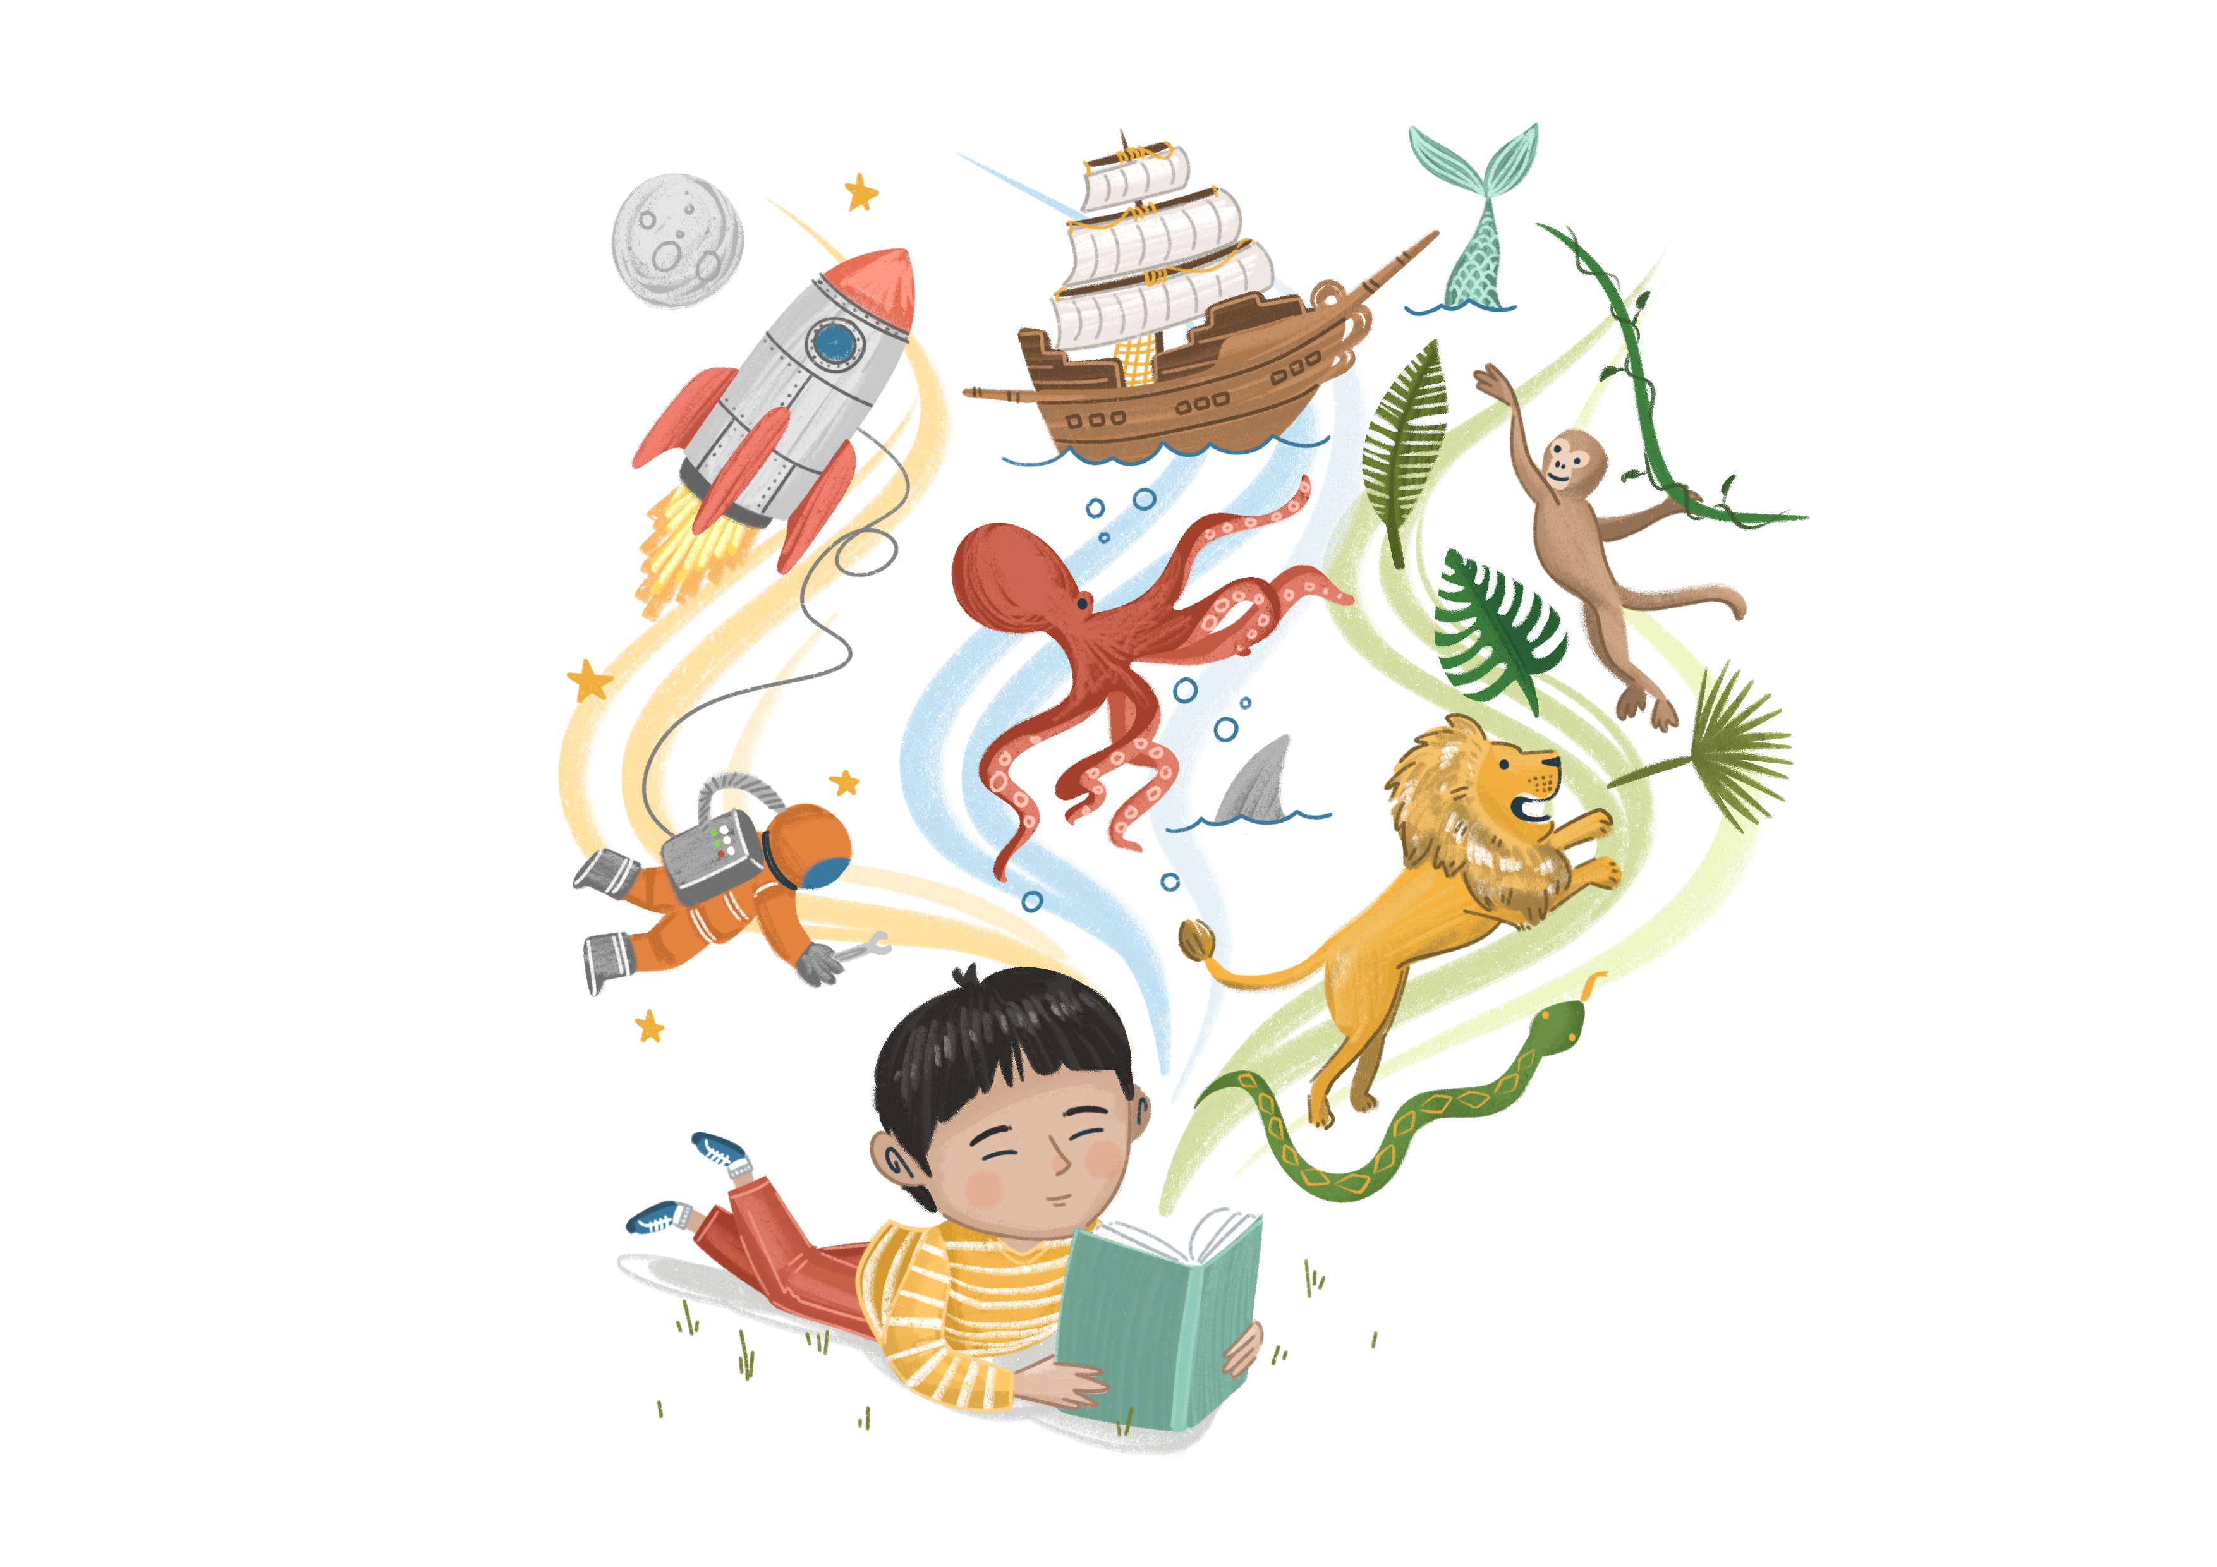
Enjoy the Story
Towards the end of the story, the author says “All of us are different. Everybody. Everywhere.” What do you think this means?
There are 28 different ways to be supported in the book!
Which of the ways to be supported were your favourite? Why?
Were there any ideas that you wouldn’t like if you were feeling sad?
ead
Notes:
Share the story with pupils. As they listen to the book, ask children to think about how they like to be supporting during difficult times.
Use the suggested comprehension questions in the PPT to develop pupils’ understanding of vocabulary, retrieve information, and infer meaning.
Encourage children to think about how everyone is different and likes to be supported in different ways. For many people, a combination of things helps them to feel better. Encourage children to think about how they like to be supported.

Slide 9
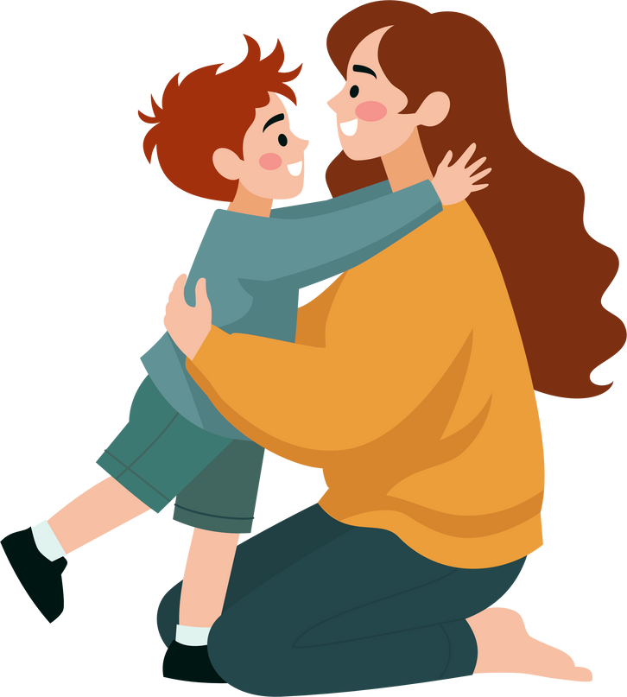
Class Discussion
How do you know when you need support from a friend or family member?
Who supports you during difficult times?
ou
Notes:
This discussion is designed to encourage children to think about when they might need extra support. Have children think about who they would go to in difficult times too.
This could include physical signals from their bodies, changes in emotions, or after an upsetting incident. For example:
Just not feeling like themselves or they feel sad but don’t know the reason
After a difficult experience
When something in their bodies is hurting
When they are worried about something
When they feel jittery
When they have very big emotions that they are finding hard to manage
If somebody has told them something worrying or they have seen something worrying
When their heart rate is increased or they have sweaty palms
When they just feel like they need a hug

Slide 10

Activity A
My Support Bingo
Let’s play bingo!
Write down 6 ways you like to be supported when you are sad.
ou
Notes:
Choose either A or B
Activity A: My Support Bingo
Using the bingo template in the lesson plan document, ask children to write/draw 6 ways they like to be helped or supported by a friend when they are experiencing a tough time.
Discuss the children’s answers as they complete their bingo cards to encourage reflection on why each one works for them. As they are working, note each idea on a small piece of paper and put it in a jar or box.
Play Bingo! Shuffle the paper in your box, select one and read it out. If a child has idea, they can put a tick through it on their grid. The winner shouts ‘bingo’ when all 6 ideas have been ticked.
Think about which answers have been the most popular and discuss why. Reinforce the idea that everyone likes to be supported in different ways.

Slide 11
Activity B
My Bear Footprint
Who supports you when you feel sad? What do they do they helps you to feel better?
My sister
Makes me laugh
ou
Notes:
Using the bear footprint template in the lesson plan document, ask children to draw a picture of themselves in the bear’s palm.
Above each of the 5 fingerprints, they should write a person who helps them when they are sad. It could be a teacher, friend, family member etc. Then in the middle of the fingerprint, write how they like to be supported by that person.
If there is time, children can colour in the bear footprint too.
Ask children to explain why they like to be supported in this way, if they can. E.g. My Grandad gives me a hug when I feel sad, it cheers me up and I like it.
Share some examples, especially ones that differ from each other to highlight how everyone has different people in their lives that help them in different ways.

Slide 12
Lesson 2
Notes:
If necessary, re-introduce what The Story Project is about, revisiting previous learning from last week. You may also wish to remind children about any Ground Rules you have agreed together.

Slide 13

Retrieval Time
What ways do you like to be supported?
Who supports you when you are feeling sad?
Notes:
Remind children of any ground rules you agreed last week.

Slide 14
Emotion Check-In
How are you feeling today?

Slide 15
Our Book
Title:
How to Mend a Friend
Author and illustrator:
Karl Newson
Clara Anganuzzi

Slide 16
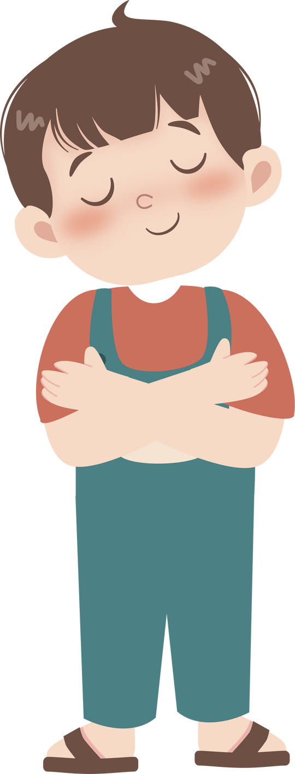
‘Bear Hugs’
ettle
Let’s get ready for our lesson by settling down.
Notes:
Imagine you are the child on the front cover, ready to help your friend the bear.
Take your arms out wide, breathing in deeply and slowly.
As you breath out, wrap your arms around your body and give yourself a hug. Squeeze tight and sway a little, if you like. You can close your eyes if you would like.
Take another big deep breath and release your arms, placing them back by your sides.

Slide 17
Emotional Vocabulary
Look at the page where the wolves are gathered around the campfire.
How is each character feeling?
raining
Notes:
Look at page where the wolves are gathered around the campfire.
The howling wolf appears to be sharing a memory or feeling, most of the other wolves are happy listening. However, one is walking away. Why might that be? How do the children think the wolf is feeling?

Slide 18
I can tell you how I would support a friend during difficult times
bjective
Notes:
As they listen to the book, ask children to think about how they like to be supporting during difficult times.

Slide 19
Enjoy the Story
Why do you think different people like to be supported in different ways?
Look at the page where the little girl is looking up at the squirrels in the tree. It says “some friends have a list of things they’d like to try to do”. What types of things do you think people like to do to feel better?
On the following page, it says “…sitting, doing nothing much, and saying not a word”. What does that mean?
ead
Notes:
Share the story with pupils. You can re-read the whole book or just dip into pages that resonate with your class.
Use the suggested comprehension questions to develop pupils’ understanding of vocabulary, retrieve information, and infer meaning.

Slide 20
Class Discussion
How can you tell when a friend needs help?
How can you tell what help they might need?
ou
Notes:
It is quite a tricky skill to be able to tell when others need help, especially if they don’t verbalize it. It can also be difficult to know what our friends need. This discussion is designed to support children’s understand of other people’s needs. This can be quite a nuanced conversation and there isn’t a right or wrong answer. It is also important to gently remind children that it isn’t their responsibility to ‘fix’ or ‘mend’ their friends, just to try to be there for them when they feel sad.
How to tell when a friend needs helps. Some ideas might include:
A change in behaviour or them not acting like themselves
Them not wanting to play or not wanting to go outside at lunch/break time
Them having more big emotions than usual
How to tell what help they might need. Some ideas might include:
Asking them; they might be able to tell you what they need. It’s ok to say ‘I don’t what to do to help, but I am here for you’.
Thinking about what the person usually likes doing (e.g. they love reading, so one idea might be to offer to go to the library together).
Asking a trusted grown up for advice.
Doing something small for them to let them know you’re there e.g. sharing a biscuit, giving them a smile, or simply sitting next to them.
Asking them if they’d like to chat. They might not tell you what they need, but just having somebody to talk to can be really powerful.

Slide 21

Activity A
Thought Bubbles
What do you think these characters are feeling?
ou
Notes:
Select a scene from the book and ask children to think about what a character may be thinking. Ask them to look at the character’s body language, facial expression and the space they occupy within their surroundings.
When they have an idea, ask them to write the thought onto a thought bubble (optional template in lesson plan document). Repeat for other characters in that scene.
Read the thoughts aloud as you point to each character and then ask which character is showing that they are feeling sad and who may need some support to feel better. What do the children think they or another character could do to help?
Repeat for as many scenes in the book as you would like to.
If you have extra time, recreate one of the scenes as a ‘still frame’ with a child taking on the role of each character. As the children ‘freeze’, walk around the scene describing the setting. Indicate to each child when it is their turn to say their thought bubble. Refer to the discussion question and ask children their thoughts related to this scene.

Slide 22
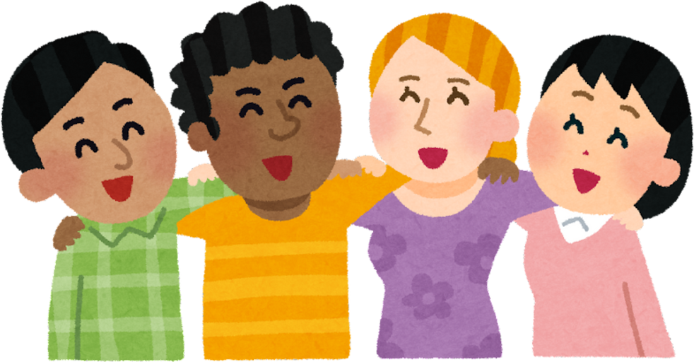
Activity B
Supporting a Friend
Who supports you when you feel sad? What do they do they helps you to feel better?
ou
Notes:
Print out the scenarios in the lesson plan document or use the next few slides.
In groups or as a whole class, talk about what the children would do in each scenario. How would they help their friend?
Encourage them to think carefully about the ‘About’ section and try to think of ideas that they think that person would like.
Discuss how everybody needs different things and different types of support at different times in their lives.
Remind children that if they are very worried about a friend, they should tell a trusted adult.

Slide 23
Activity B
Supporting a Friend - Scenarios
Myles has arrived at school looking very sad this morning. At break time he tells you that he broke a special toy at the weekend and it can’t be fixed.
About Myles: Myles loves listening to music and sport. He has a small group of friends and feels shy quite easily.
Josef’s best friend has moved to another school far away. He really misses him and is finding it hard to make a new friend.
About Josef: Josef loves writing. He is very creative and his favourite lesson in school is art.
ou

Slide 24
Activity B
Supporting a Friend - Scenarios
Kate has been feeling upset recently because her Grandma is poorly. She didn’t want to play out at lunch time today.
About Kate: Kate is happiest when she is with her friends. She loves to chat to her friends and especially enjoys sitting together in the library and reading.
Sammie’s pet cat died last week and although he is trying hard to join in with his friends he just doesn’t seem like his usual happy self.
About Sammie: Sammie is a happy and confident young boy. He loves telling jokes and making up funny dances.
ou

Slide 25
Activity B
Supporting a Friend - Scenarios
Lola’s uncle died recently. She was away from school for a little while and she has just returned. She would like to talk about her Uncle and tell you some of her special memories about him.
About Lola: Lola loves drawing and playing board games. She also loves chocolate!
Aisha broke her leg in the summer holidays and had to stay overnight in hospital. Her leg is much better now but she must be careful when playing in the playground. She is sad that she can’t run as fast as normal.
About Aisha: Aisha’s favourite sports are running, football and basketball. She also loves painting.
ou

Slide 26
Lesson 3
Notes:
If necessary, re-introduce what The Story Project is about, revisiting previous learning from last week. You may also wish to remind children about any Ground Rules you have agreed together.

Slide 27
Retrieval Time
What things can we do to support a friend during a difficult time?
Does everyone like to be supported in the same way? Why?
How can you tell when a friend needs help?
Notes:
Remind children of any ground rules you agreed last week.

Slide 28
Emotion Check-In
How are you feeling today?

Slide 29
Our Book
Title:
How to Mend a Friend
Author and illustrator:
Karl Newson
Clara Anganuzzi

Slide 30




‘Friend Affirmations’
Let’s get ready for our lesson by settling down.
ettle
I am a
GOOD
FRIEND
I am a
GOOD LISTENER
I have
GOOD IDEAS
Notes:
Help children get ready for the lesson by completing this settle activity.
Affirmation definition: A simple, positive statement that you can repeat to yourself to help build confidence and self-esteem. Some people who use positive affirmations say them to themselves every morning.
Look at our friend affirmations on the board
Which one best describes you? Pick your favourite one.
You can either say it in your head to yourself or write it down. Practise saying this affirmation to yourself regularly through the day.

Slide 31
Emotional Vocabulary
Look at the page with the lion and the meercats.
How is each character feeling?
raining
Notes:
Look at the page where the lion is in the tree and the meercats are looking up at her.
How do children think the lion is feeling? How do they know?
How do children think the meercats are feeling?

Slide 32
I can explain what my strengths are and how they make me a good friend.
bjective

Slide 33
Enjoy the Story
Why do you think Karl Newson chose to write this story? How do you think Karl felt receiving all those elephants?
What skills and qualities do you think Karl’s friends have, that made them so good at supporting him?
After his friend posted on social media, Karl received images of elephants from people who didn’t even know him. Why do you think they wanted to help?
ead
Notes:
Recap the story, reminded children of the important learning from the previous sessions (how they like to be supported and how they can support a friend).
Summarise Karl Newson’s note at the end of the book….
Karl reflects on his experience of serious illness and how the support of his family and friends made such a difference to him at a very difficult time of his life. Karl recovered from cancer, but this may not be the case for children in your group who have been bereaved because of cancer, so it’s important to be sensitive to their individual experiences and not read it in its entirety if this is the case. The purpose of sharing his story is to show that support can come in many different forms and from different people — and that, for Karl, it was the combination of these acts of friendship that helped him feel truly loved and supported.
Tell the children that whilst Karl was in hospital, before he’d written this book, a friend sent him a picture of an elephant and started the hashtag #elephants4karl on social media. Soon a herd of elephants came his way, they were drawn, knitted, painted and written about. Karl said in an interview, “It was AMAZING! I got such a big boost from it.”

Slide 34
Class Discussion
What makes a good friend?
Is it really possible to ‘mend’ a friend?
ou
Notes:
For the first part of this discussion let children think and talk about what makes a good friend. Ideas might include:
Being good at listening
Being confident
Being fun and imaginative
Helping each other when things are difficult
Sharing
Speaking respectfully
Saying sorry when its needed
Then, steer the conversation to a discussion about what our role is as a friend. Gently remind children that it isn’t our job to ‘mend’ or ‘fix’ our friends when they are going through a difficult time. Although the title of the book is ‘How to Mend a Friend’, all we can really do is simply be there for our friends – offering kindness, understanding and support in whatever way they need.

Slide 35
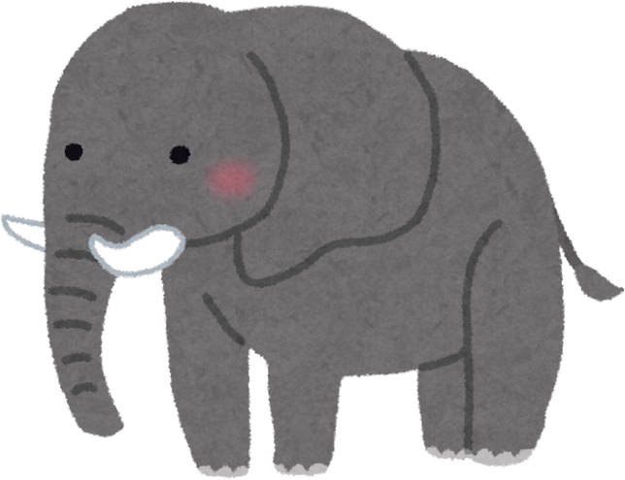
Activity A
Trunks of Support
What is your individual strength as a friend?
ou
Notes:
Ask children to create a picture of an elephant – in any style, in any way. You can also use the elephant template provided in the lesson plan document if you’re short on time.
Ask children to add a label or thought bubble to express their individual strength as a helper/friend, e.g. a good listener, baker, hugger etc.
If a child has lots of ideas, they can fill the elephant with them!
Share a few examples. Ask children why they think this strength would help a friend in need?
Finally, drawing children’s thoughts back to the title of the book, gently reinforce the idea that when someone is going through a difficult time, our role isn’t to ‘fix’ or ‘mend’ them. Our role is to simply be there – offering kindness, understanding and support in whatever way they need.

Slide 36

Activity B
Elephant Talk
What makes you a good friend?
ou
Notes:
Have the children sit in a circle. Explain that we are each going to be sharing one thing that makes us a good friend. Give children a minute to think about what this might be, giving a few examples if needed.
Pass the toy elephant (or small object) to the first child in the circle. It is their turn to say what makes them a good friend. Then they should pass the elephant to the next person, until everyone in the circle has had a turn.
Discuss a few common examples and talk about why that makes them a good friend.
Finally, drawing children’s thoughts back to the title of the book, gently reinforce the idea that when someone is going through a difficult time, our role isn’t to ‘fix’ or ‘mend’ them. Our role is to simply be there – offering kindness, understanding and support in whatever way they need.

Slide 37
The Marfleet Foundation
The Story Project

