Slide 1




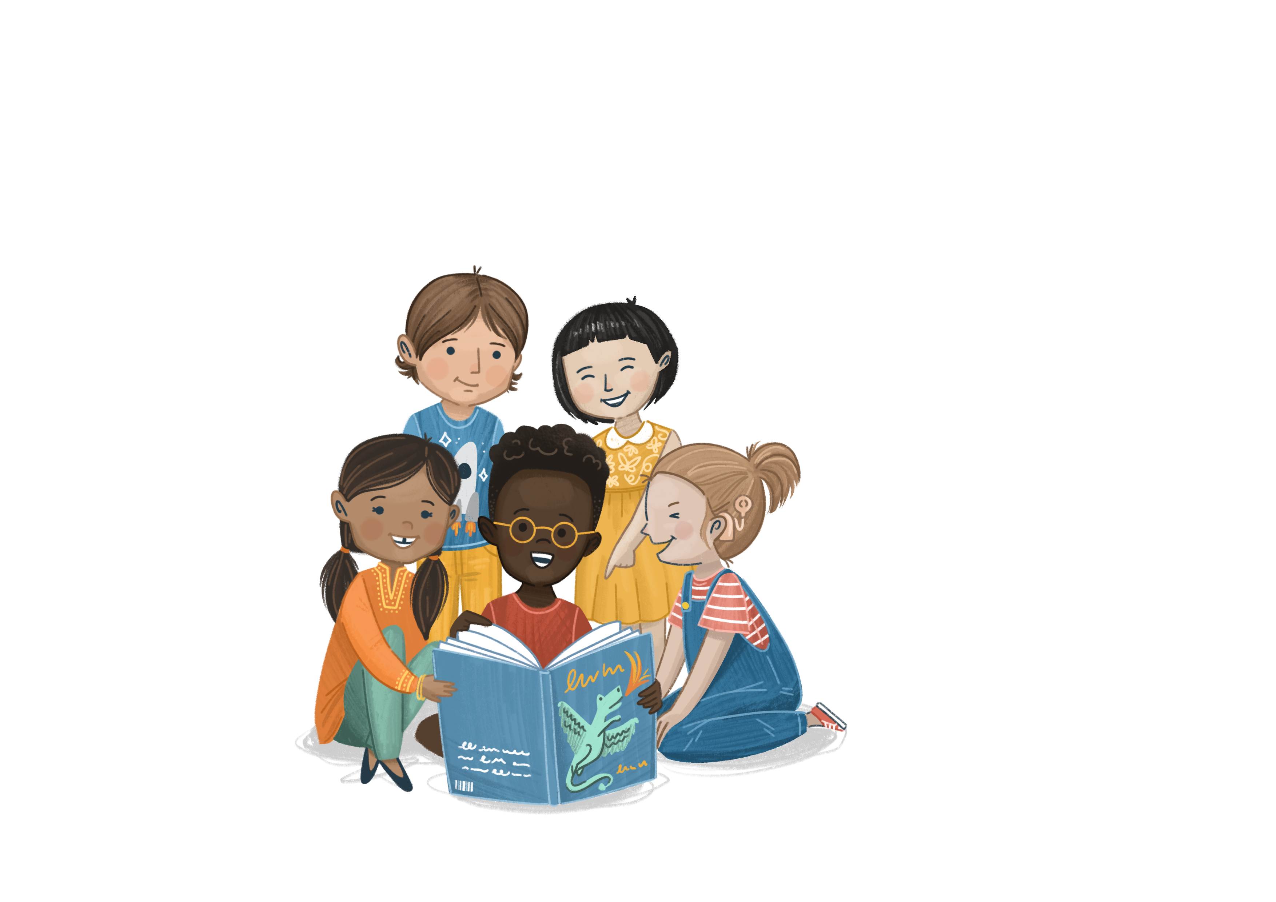

Welcome to
©The Story Project CIC

Slide 2





Wellbeing
What does wellbeing mean?
Wellbeing means feeling happy, healthy, and safe.
It’s about taking care of your body and mind so you can enjoy life, play, learn, and feel good inside and out.

Slide 3

Emotion Check-In
How are you feeling today?

Slide 4

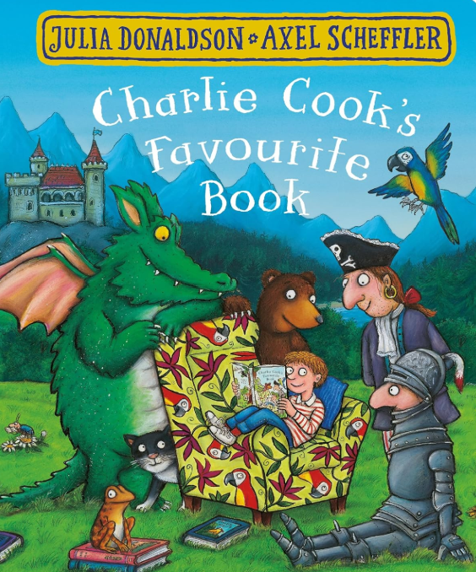
Our Book
Title: Charlie Cook’s Favourite Book
Author: Julia Donaldson
Illustrator: Axel Scheffler

Slide 5

Open and Close Breaths
ettle
Let’s spend a few minutes getting ready for our lesson.
Notes:
Ask children to hold an imaginary book in front of them.
Encourage them to take a deep breath in when they open the imaginary book and breath out when they close it.
Repeat.

Slide 6
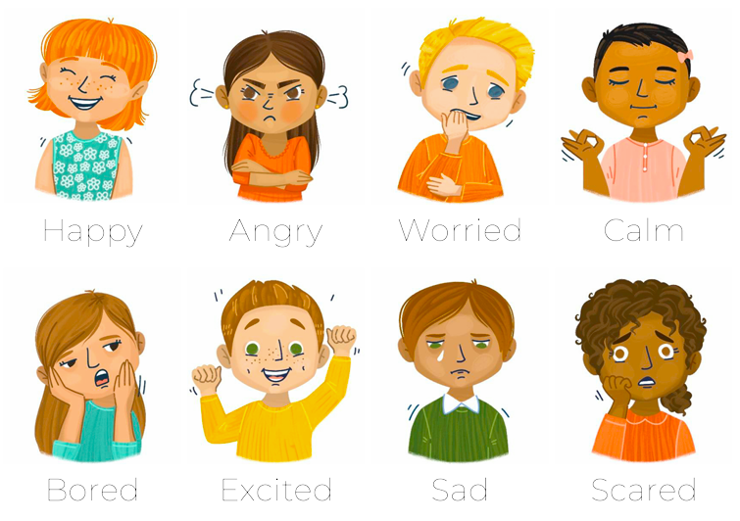
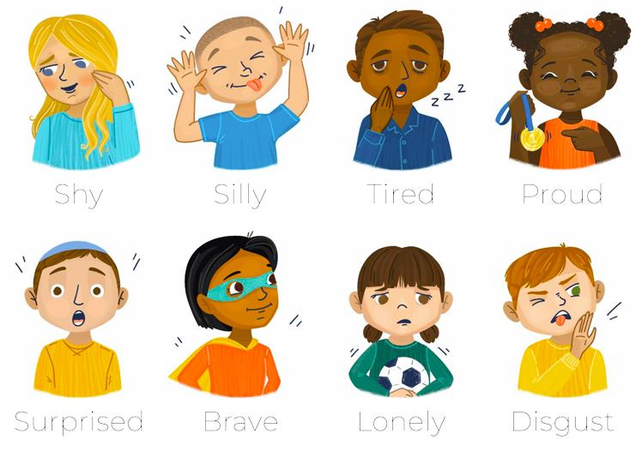
Emotional Vocabulary
Look at the picture of Charlie on the front cover
How do you think he is feeling? How do you know?
raining
Notes:
Look at the front cover of the book.
How could Charlie be feeling? How do you know?
From the illustration, can you describe how he might feel about reading? Try to encourage children to go beyond happy and sad to expand their emotional vocabulary.

Slide 7

I can tell you what books my friends and I like to read
bjective

Slide 8
Enjoy the Story
Can you remember some of the types of texts shown in the story?
Why do you think the author chose to show all these different types of books in the story?
What type of books do you think Charlie likes to read? Can you think of an example of books in our classroom that he might like?
What books do you like to read?
ead
Notes:
Edit the guided reading questions as needed

Slide 9
Class Discussion
Do you think everyone should read the same type of book?
Let’s discuss together
ou

Slide 10
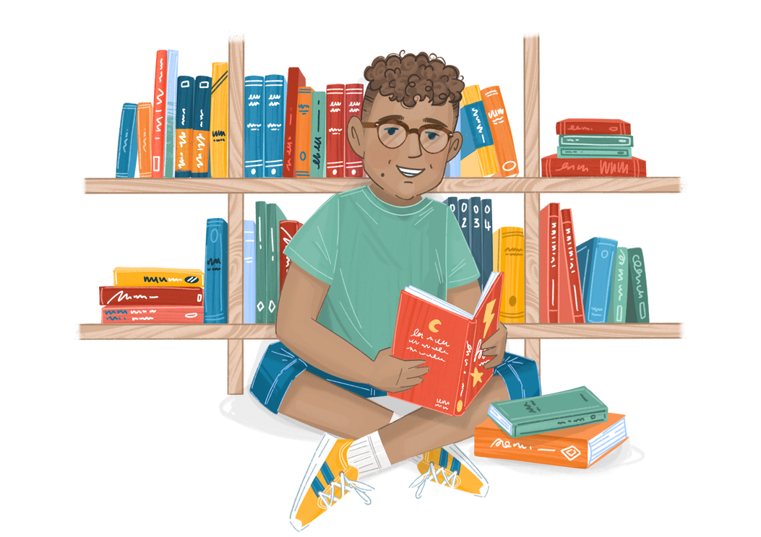
Activity A
The Big Book Swap!
Can you find a book that your friend might like to read?
ou
Notes:
Talk to the children about how everyone has different hobbies and interests. Give an example of something you enjoy reading about and how this might be different to other people.
Put the children in pairs and give them a minute or so to talk to each other about what they like to read or what their interests are.
Using your school library or book corner, set the children the task of choosing a book for their partner that matches their interests.
Then do the big book swap! Ask a few children to share why those chose the book for their partner.

Slide 11
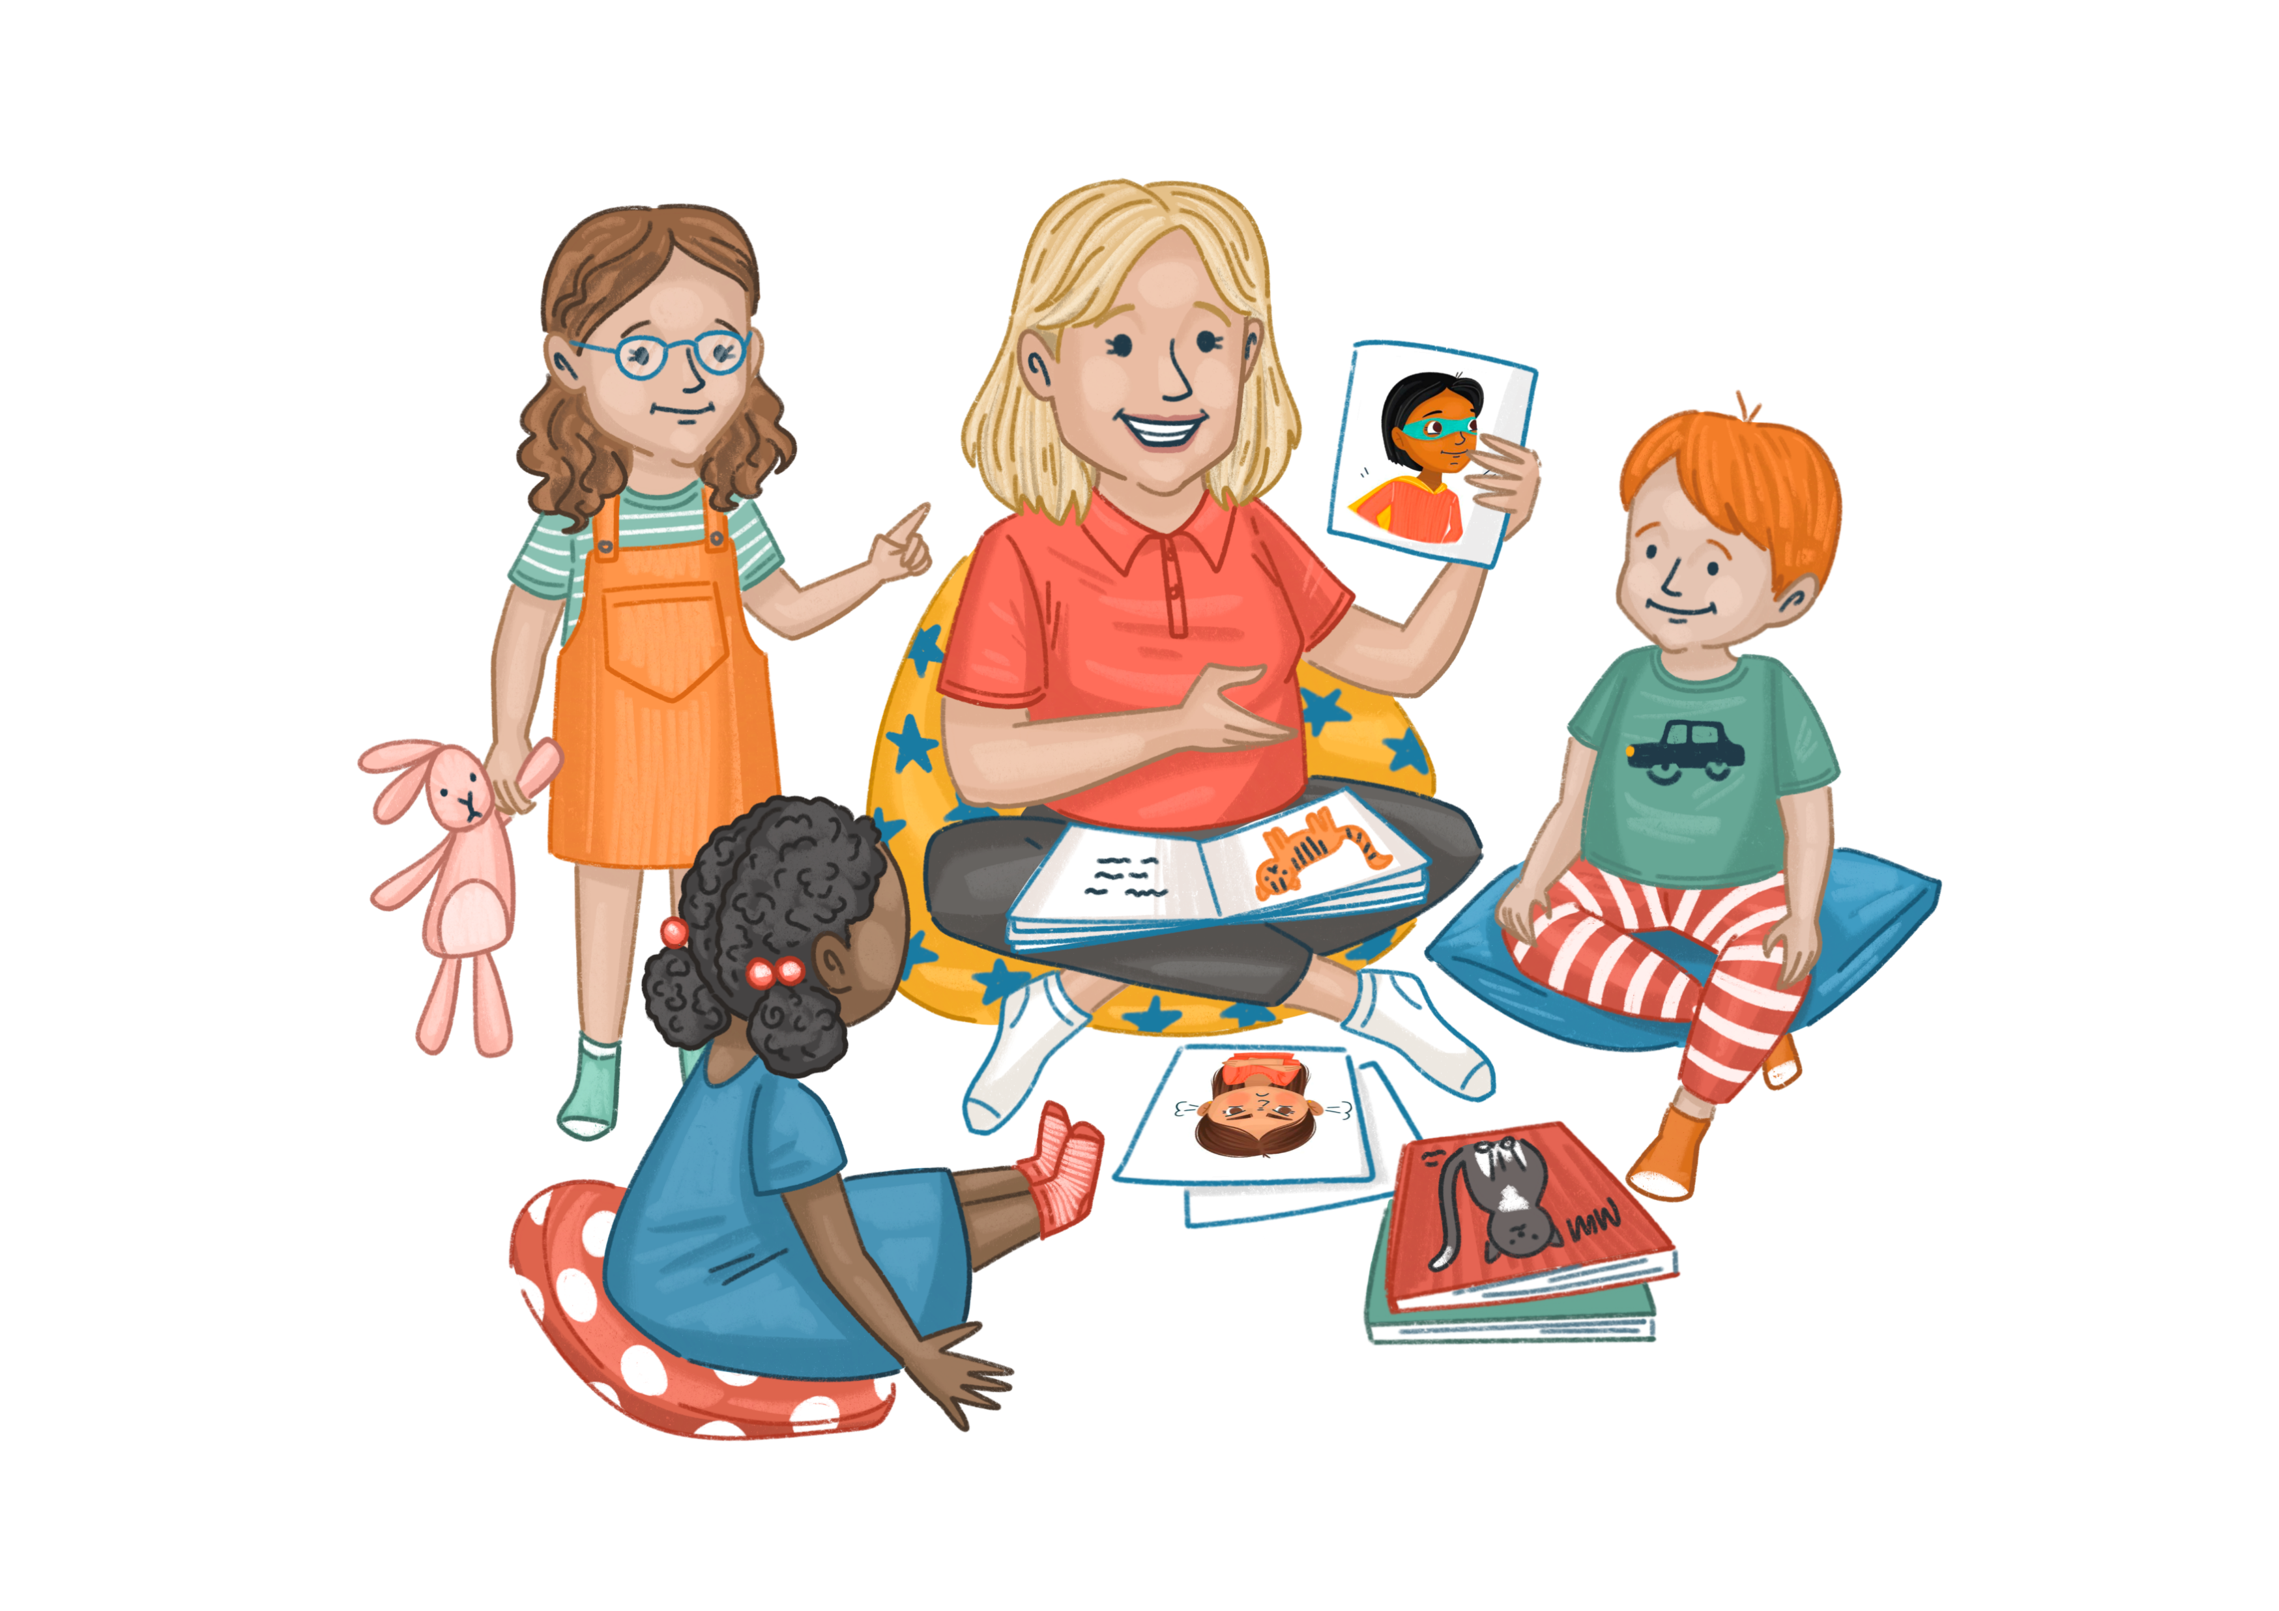
Activity B
Reading Wish List
What would you like to see in the next book you read?
ou
Notes:
Ask the children to think about what types of books they would like to read. You can do this individually on paper or as a class.
Ask the children to create a ‘wish list’ of their next read – what characters would be in it? Would it have a happy ending? Would it be set in our world or a different world? Would it have pictures or be all text? Etc.
Ask children to design a front cover for their ‘wish list’ book.
Extension activity - Can they find a book like this in the library or book corner?

