Slide 1




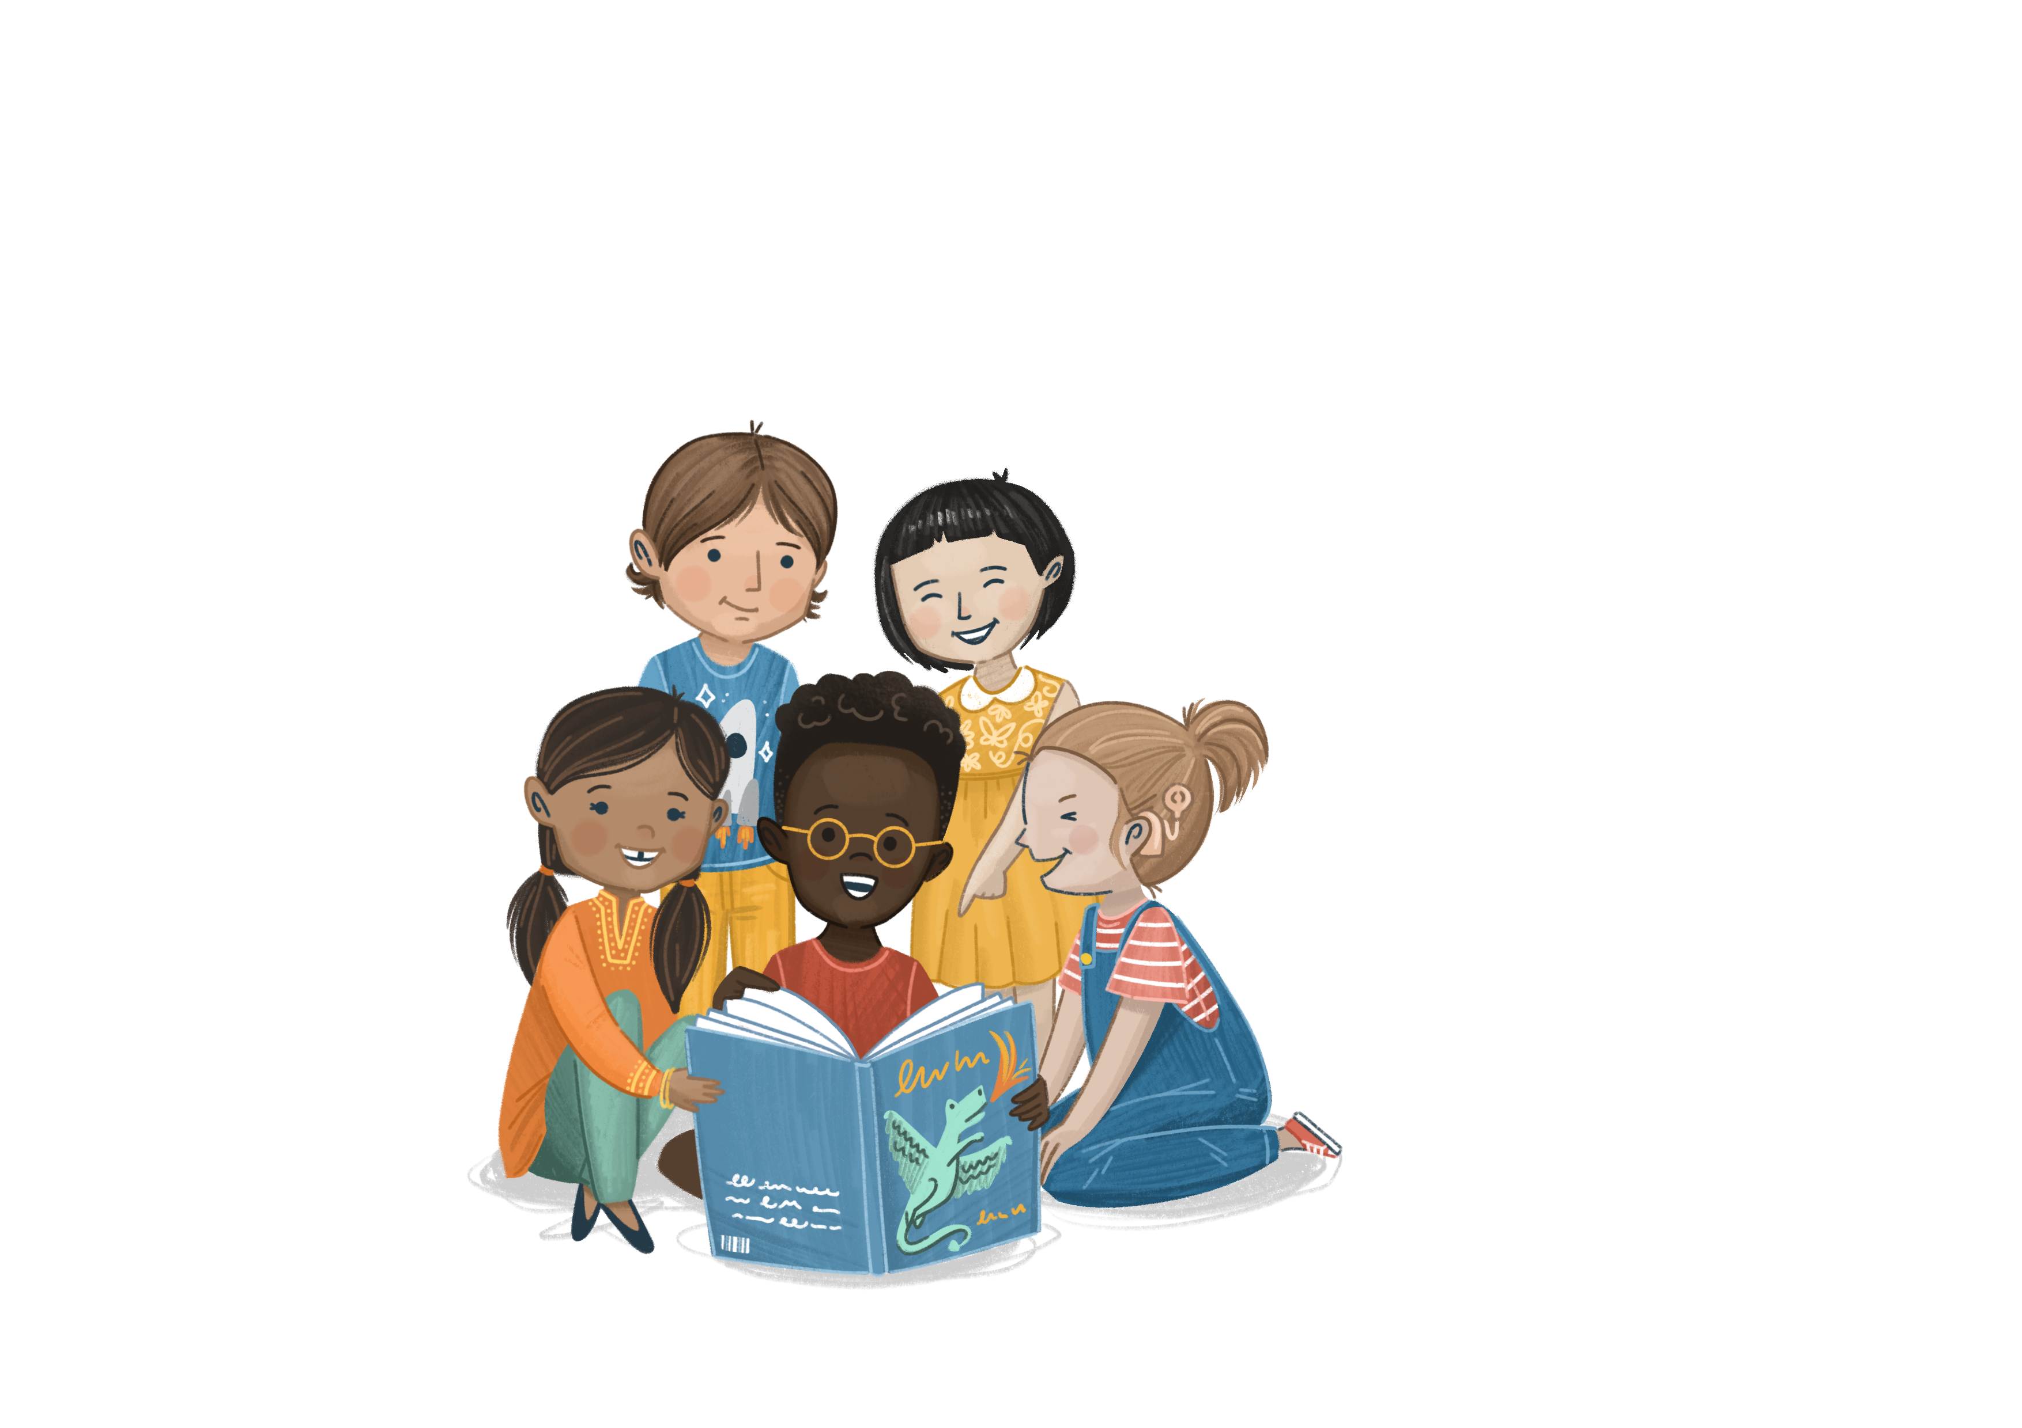

Welcome to
©The Story Project CIC

Slide 2
Lesson 1
Notes:
Revisit the Ground Rules that your class wrote together following their introduction to The Story Project.
Ground rule suggestions:
We listen to everyone’s opinions respectfully
We join in with the lesson calmly
It is ok to have different opinions and ideas
We are inquisitive and excited to learn
If we are worried about something, we talk to a trusted adult
If we are worried about a friend or ourselves, we talk to a trusted adult
We do not have to talk about a topic that upsets us
We have fun!

Slide 3





Wellbeing
What does wellbeing mean?
Wellbeing means feeling happy, healthy, and safe.
It’s about taking care of your body and mind so you can enjoy life, play, learn, and feel good inside and out.

Slide 4

Emotion Check-In
How are you feeling today?

Slide 5

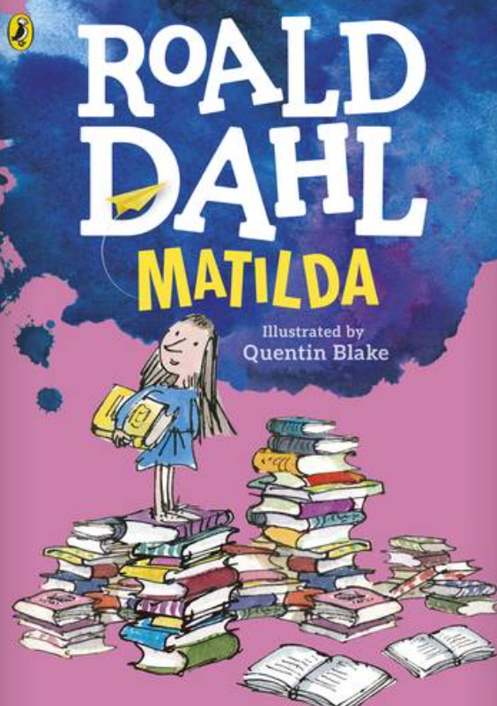
Our Book
Title: Matilda
Author: Roald Dahl
Illustrator: Quentin Blake

Slide 6

Book Wave
ettle
Let’s spend a few minutes getting ready for our lesson.
Notes:
Stand up tall. Close your eyes and take a deep breath
Reach out to the side with your left arm, wiggle your fingers.
Now place your right arm on top of your left arm.
Using your right arm, reach up and over your head like the page of a book turning.
Now repeat on the other side, taking deep calm breaths each time you ‘turn the page’.

Slide 7
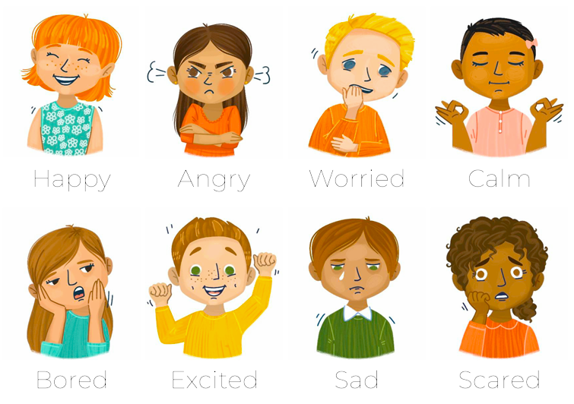
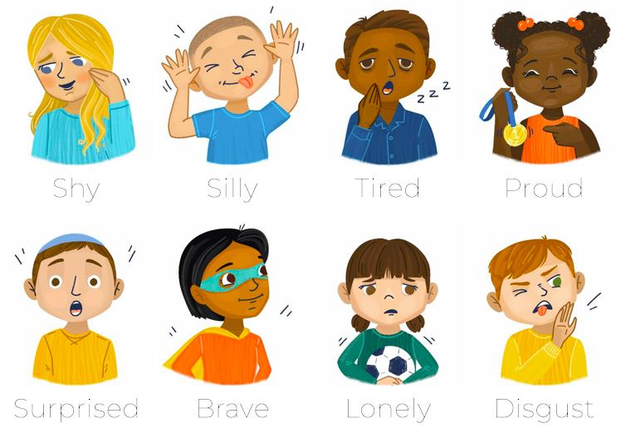
Emotional Vocabulary
Look at the picture of Matilda on the front cover
How do you think she is feeling?
From this picture, can you describe how Matilda might feel about reading?
raining
Notes:
Look at the front cover of the book.
How could Matilda be feeling?
From the illustration, can you describe how she might feel about reading?

Slide 8

I can tell you why reading is good for my wellbeing
bjective

Slide 9
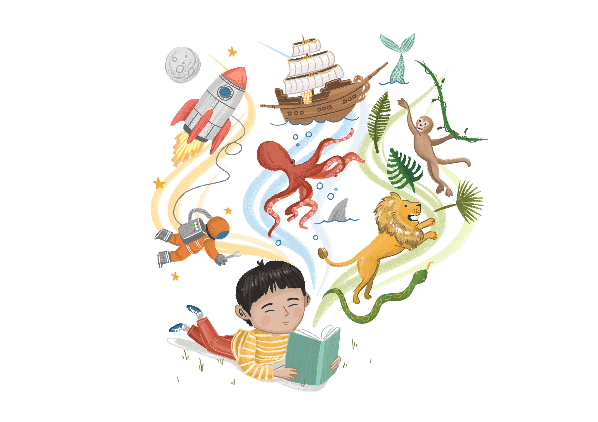
Enjoy the Story
Vocabulary:
What did the author mean when he said “the books transported her into new worlds…”
Retrieval:
What is Matilda’s father’s opinion of reading? What would he rather be doing, do you think?
Inference:
Do you think Matilda is safe when she walks to the library? Why?
Why do you think Matilda enjoys reading so much? Why do you think she enjoyed ‘escaping’ into a book?
ead
Notes:
Edit the guided reading questions as needed

Slide 10
Class Discussion
Why do you think reading is good for your wellbeing?
Let’s discuss together
ou
Notes:
There are no right or wrong answers here, the value comes in children’s sharing of ideas. Some children may not particularly enjoy reading and may not find it to be a relaxing pastime. That’s ok. Encourage them to think about why other people find reading calming, and what activities have a similar impact on them.
Possible ideas include:
Reading is fun (you can read about things you enjoy, topics you find interesting. Different genres and formats are all equally good e.g. comics etc).
Reading is calming (it slows our heart rate, provides a distraction, is quiet and naturally mindful).
Reading lets you see other people’s experiences and thoughts. This helps to build empathy and encourages a better understanding of relationships, other people’s actions and our own decision-making.
Reading supports learning
Like Matilda, books can help us feel less alone. Seeing ourselves and our own experiences reflected in books can be a very powerful experience and can help us to understand that our feelings/emotions/actions are normal.
Follow-up questions:
What other activities support wellbeing?
What are your favourite books and why? How does reading them support your wellbeing?

Slide 11
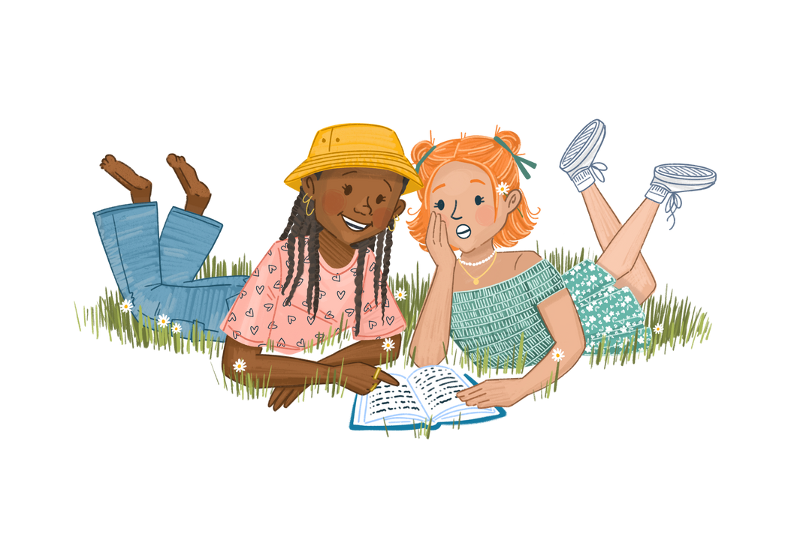
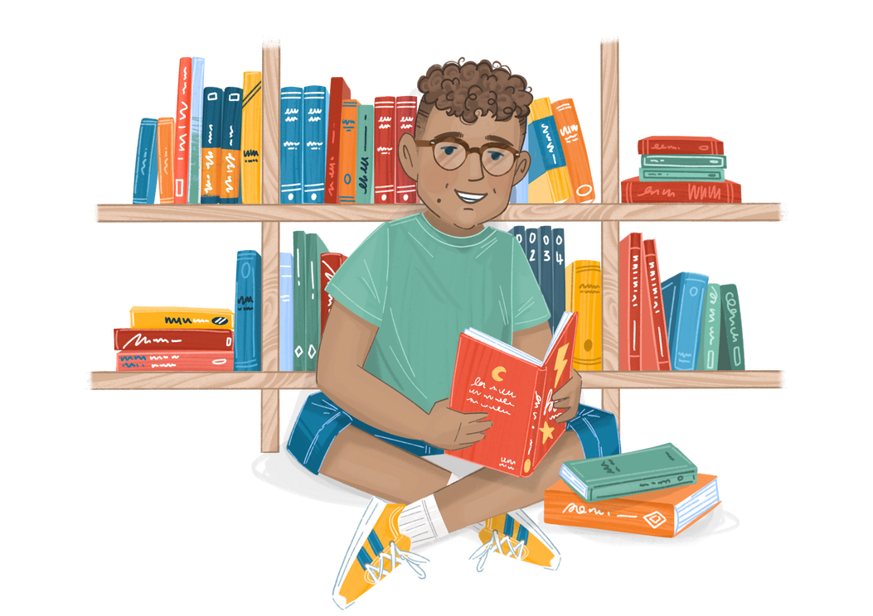
Activity A
Reading time!
How does reading make us feel?
ou
Notes:
Ask the class to go get their favourite book (or a comic, magazine etc)
Give them 5-10 minutes of quiet reading time. If possible, do this in the school library or a quiet reading area. Dim the lights slightly and invite children to get comfortable.
At the end of the session, invite children to share a little about what they have been reading. Importantly – ask each child to talk about they feel after reading. Can they compare it to how they felt beforehand? Do they notice a difference in their heart rate or mood? Are they excited or calmed by what they have read?
No writing necessary, the joy in this activity is the discussion of why reading is such a wonderful pastime!

Slide 12

Activity B
Reading Posters
How can we encourage other children to read for their wellbeing, just like Matilda does?
Design a poster to put around school.
ou
Notes:
Using ideas from the class discussion, invite children to create posters that encourage reading as a wellbeing activity.
This can be done on paper or using ICT.
You can also share reading posters from The Story Project, available alongside this resource.
Put the posters up around school and in your classroom.

